Slide 1
IOT BASED MODULAR SMART SWITCH

Slide 2
Motivation For Work
To automate the electric circuitry without changing the existing infrastructure and wiring circuit of the building using Wi-Fi based Android Application at a nominal expenditure.
Inclusion of people to technology to increase their standard of living

Slide 3
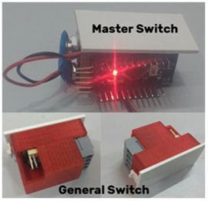
Specifications
It is based on one by one replacement model of existing switch. The current model is divided into two parts:
General Switch(Slave) : Relay and Power Supply ; 220V AC 3A/12V DC (Transformerless Power Supply)
Master Switch (Brain): Arduino Pro Mini, Bluetooth module/Wi-Fi Module and Power Supply ; 220V AC/ 5V DC(Buck Boost Converter)
Open Source Software Blynk adds to advantage

Slide 4
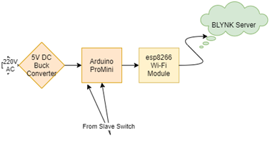
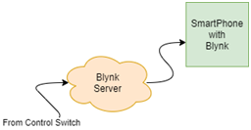
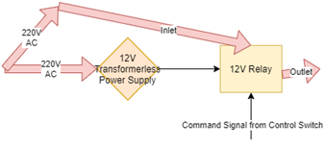
Methodology
MASTER SWITCH
SOFTWARE
SLAVE SWITCH

Slide 5

DEMONSTRATION

